Slide 1
Category review: Chips
June 2020
Retail Analytics
Brand note: If client logo is not required, use alternate title page layout right click slide thumbnail > Layout > Title

Slide 2
Notes:
To view Privacy video explaining how important data privacy is to Quantium, please click here: https://www.youtube.com/watch?v=Zq1QDAkoRzU
or here Q:\Company Reference\Brand & Design\Brand videos\Q Privacy.mp4
At Quantium, we believe that data is the behavioural footprint of humanity and that it has to be treated with the utmost care and responsibility.
Histories, attitudes, indeed lives are stored within it in ways that aren’t always apparent – and that’s what makes its potential so powerful.
To work with it responsibly, sensitively, we set ourselves the highest data privacy protection and governance standards.
We have spent 17 years perfecting privacy-by-design and secure-by-design principles. Central to this is not holding any personally identifiable information about people –
we neither receive it, and put the necessary protections in place to be unable to decipher it.
Every aspect of handling data is safeguarded: from its de-identification, to its encryption – data security is paramount and of the highest grade.
We pride ourselves on gaining the trust of iconic organisations around the world through years of securely working with their data,
and in turn the trust that builds with their stakeholders.

Slide 3
Executive summary
December is a good time for promotion, as sales increase significantly because of the festival season.
Customers prefer to buy medium size packs as 175g packs are the best-selling pack size
Kettle is considered to be the most favourite brand of all.
Sales are coming mainly from Budget - older families, Mainstream - young singles/couples, and Mainstream – retirees.
Mainstream, midage and young singles and couples are also more likely to pay more per packet of chips. This is indicative of impulse buying behaviour.
Mainstream young singles and couples are 23% more likely to purchase Tyrrells chips.
01
Task 1
Category
02
Task 2
Trial Store
Performance
During the trial period trial stores 77 and 88 show a significant difference in at least two of the three trial months but this is not the case for trial store 86.
The trial shows a significant overall increase in sales.

Slide 4
01
Category

Slide 5
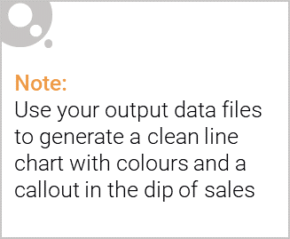
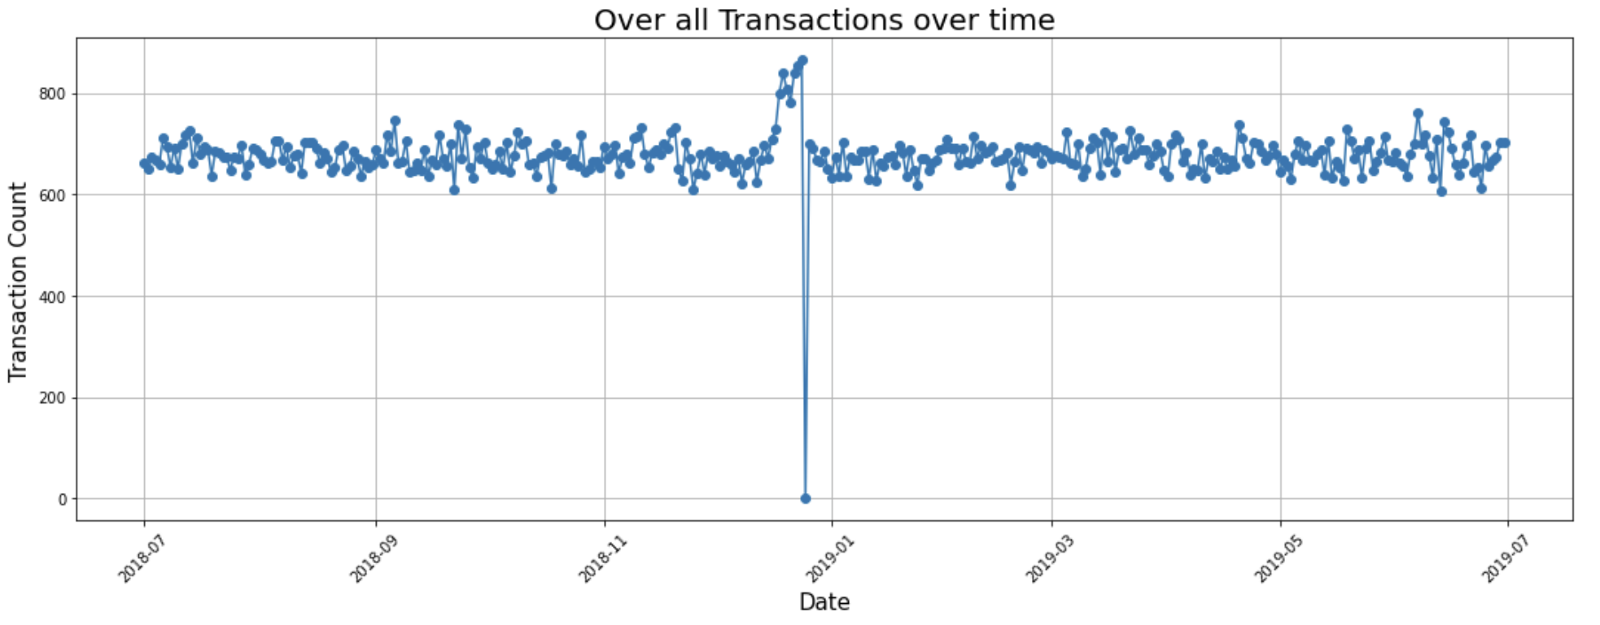
The sales of chips are between 650 to 700 transactions per day except in the month of December.
The sales of chips shoot out in the month of December.
There is also a sharp fall in the sales on the Christmas. This is due to shops being closed on Christmas day.

Slide 6
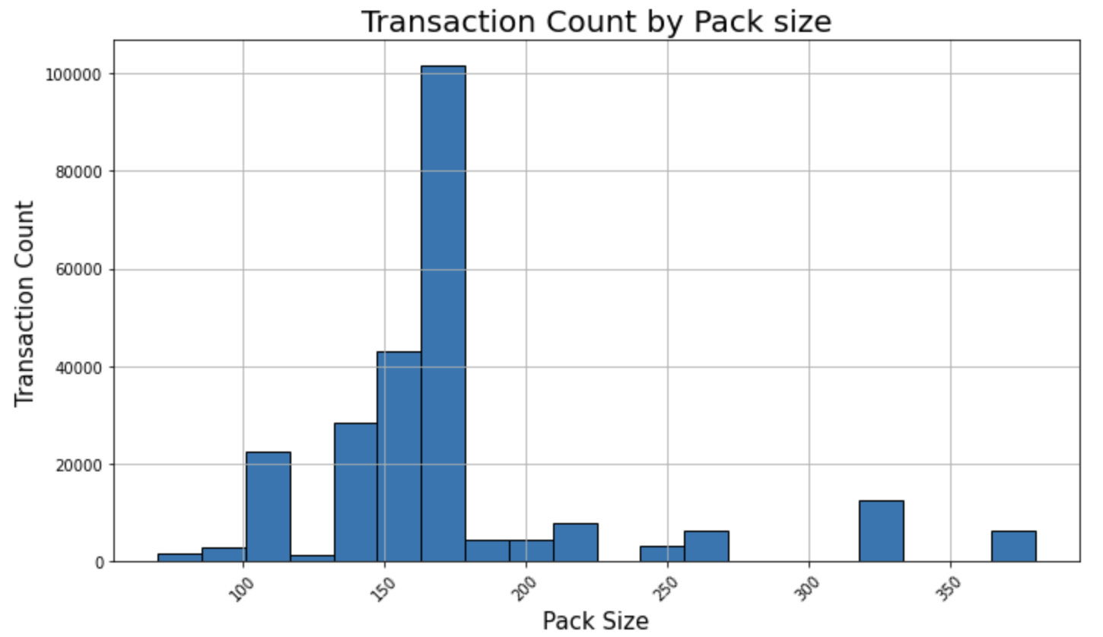
Customers prefer to buy medium size packs as 175g packs are the best-selling pack size

Slide 7
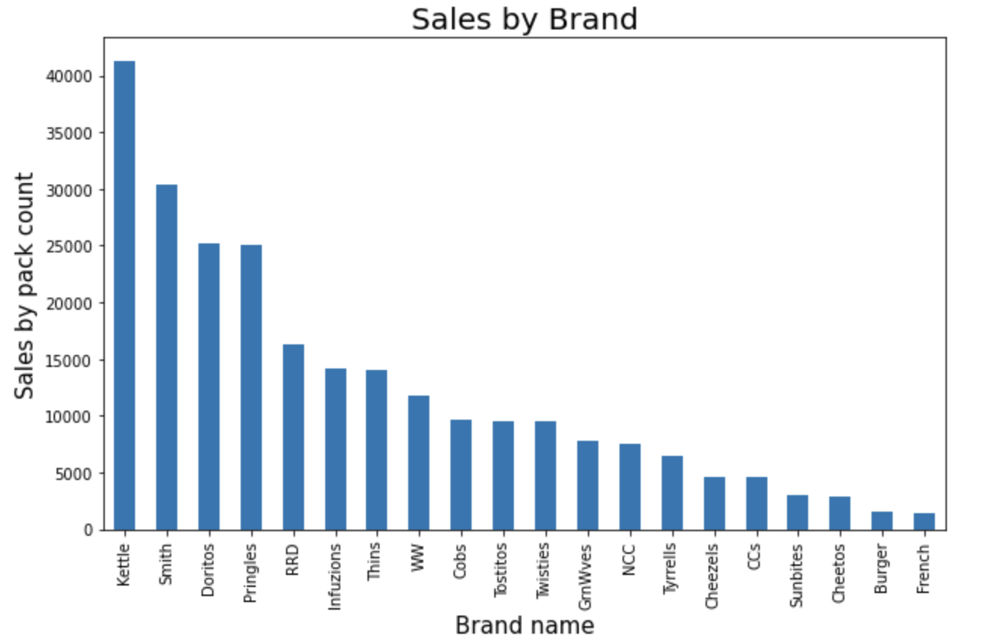
Kettle is considered to be the most favourite chips brand of all. As more than 40,000 packs are sold from the brand Kettle only.

Slide 8

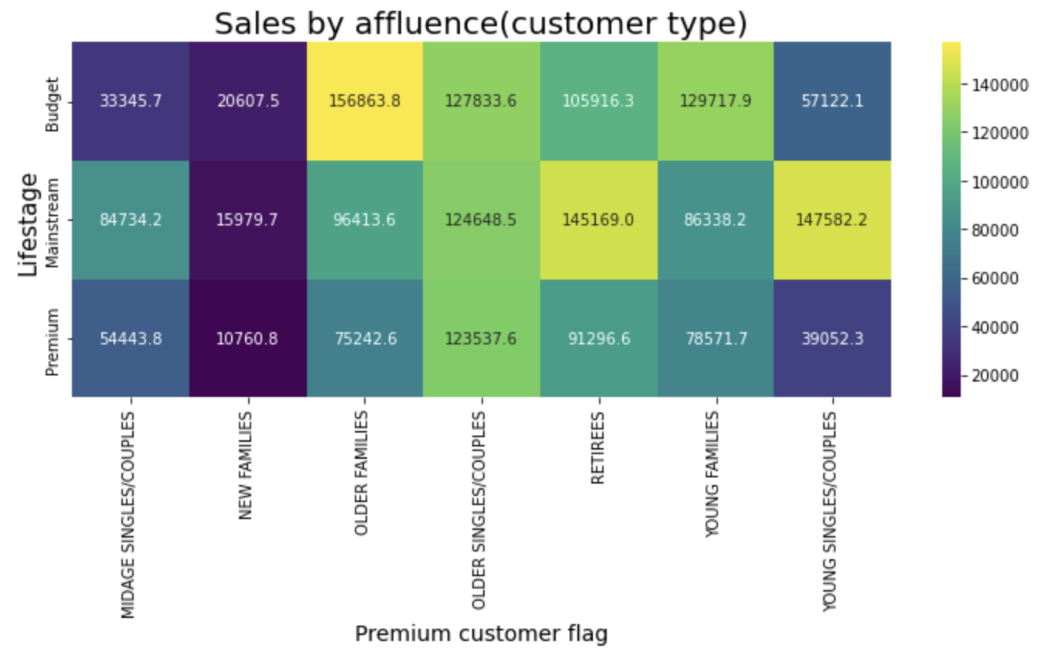
Sales are coming mainly from Budget - older families, Mainstream – young single/couples, and Mainstream retirees.

Slide 9
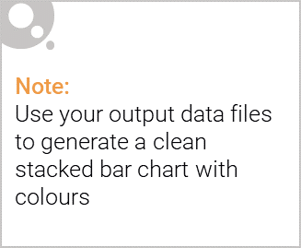
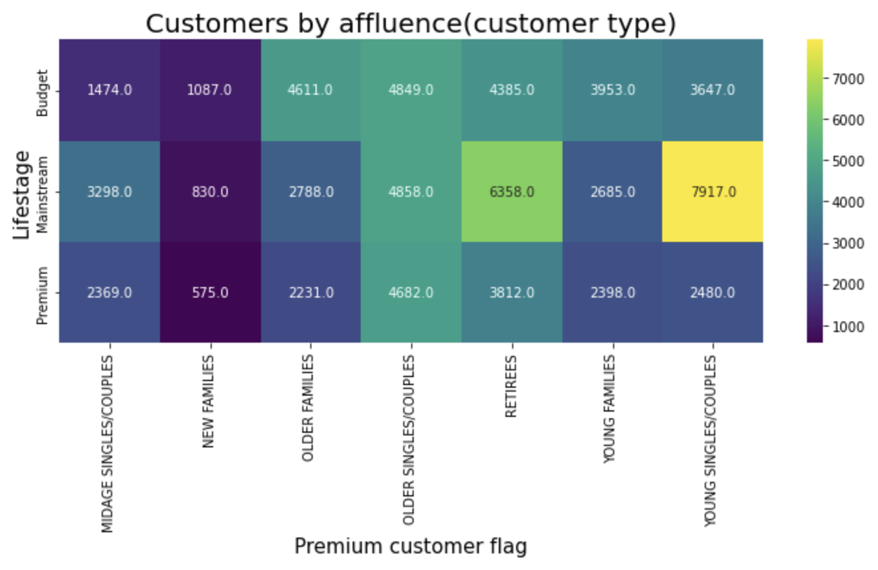
Editable (delete this)
There are more Mainstream - young singles/couples and Mainstream - retirees who buy chips. This contributes to there being more sales to these customer segments but this is not a major driver for the Budget - Older families segment.

Slide 10
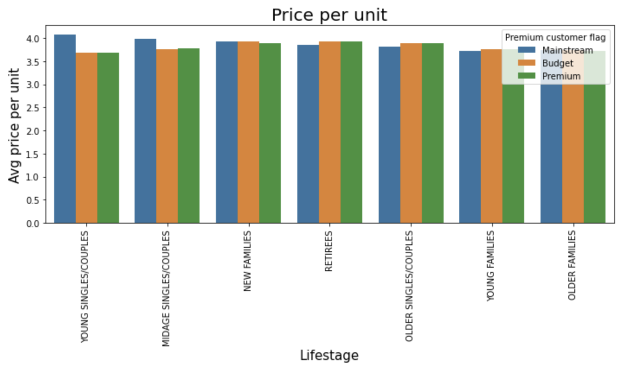
Editable (delete this)
Mainstream midage and young singles and couples are more willing to pay more per packet of chips compared to their budget and premium counterparts.

Slide 11
02
Trial store performance

Slide 12
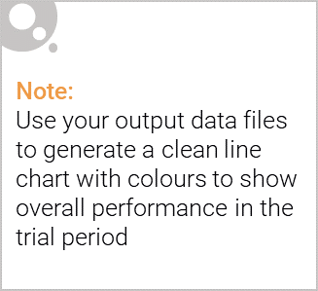
Explanation of the control store vs other stores
Trial Store | Control Store
77 | 233
86 | 155
88 | 237
Selection of control store is based on how similar the trial stores to the control store in terms of
Monthly overall sales revenue
Monthly number of customers
Monthly number of transactions per customer

Slide 13
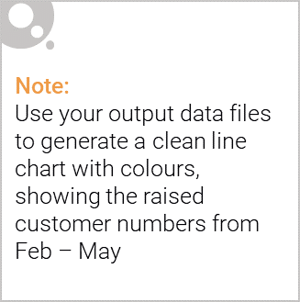
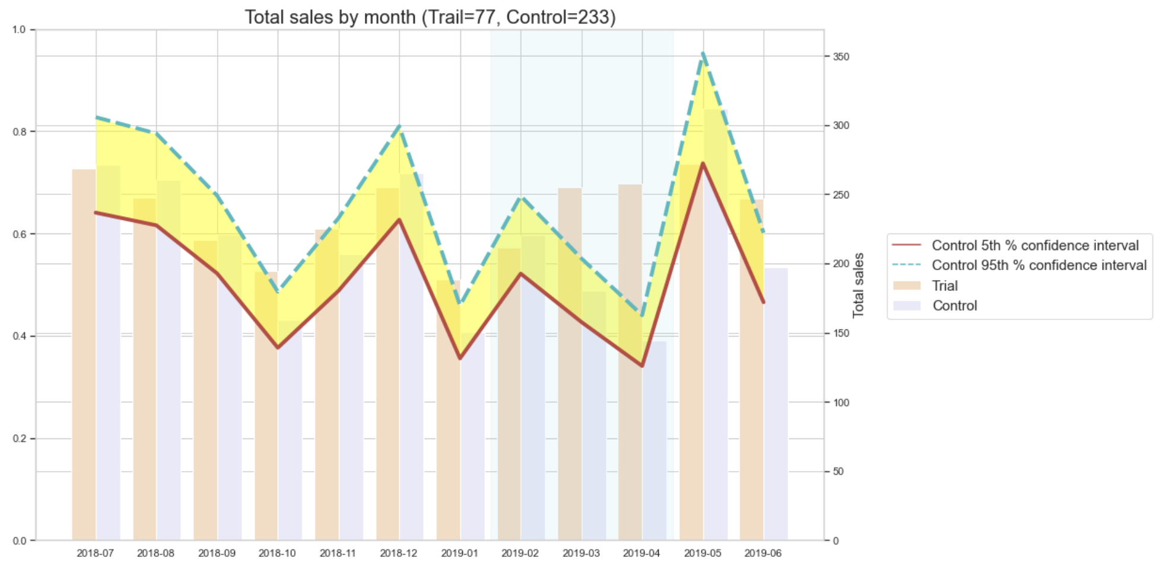
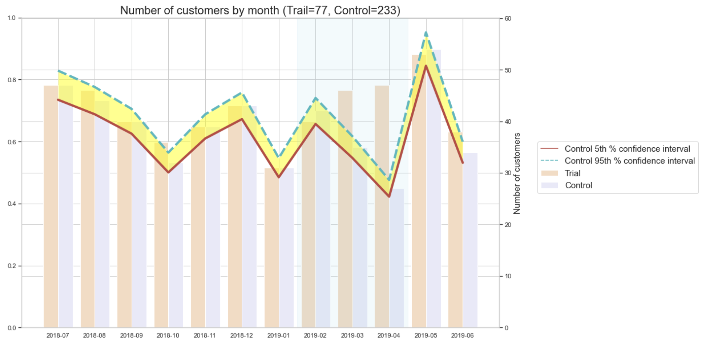
Store 77
The results show that the trial in store 77 is significantly different to its control store(233) in the trial period as the trial store performance lies outside the 5% to 95% confidence interval of the control store in two of the three trial months.
The results show that the trial in store 77 is significantly different to its control store(233) in the trial period as the trial store performance lies outside the 5% to 95% confidence interval of the control store in two of the three trial months.

Slide 14
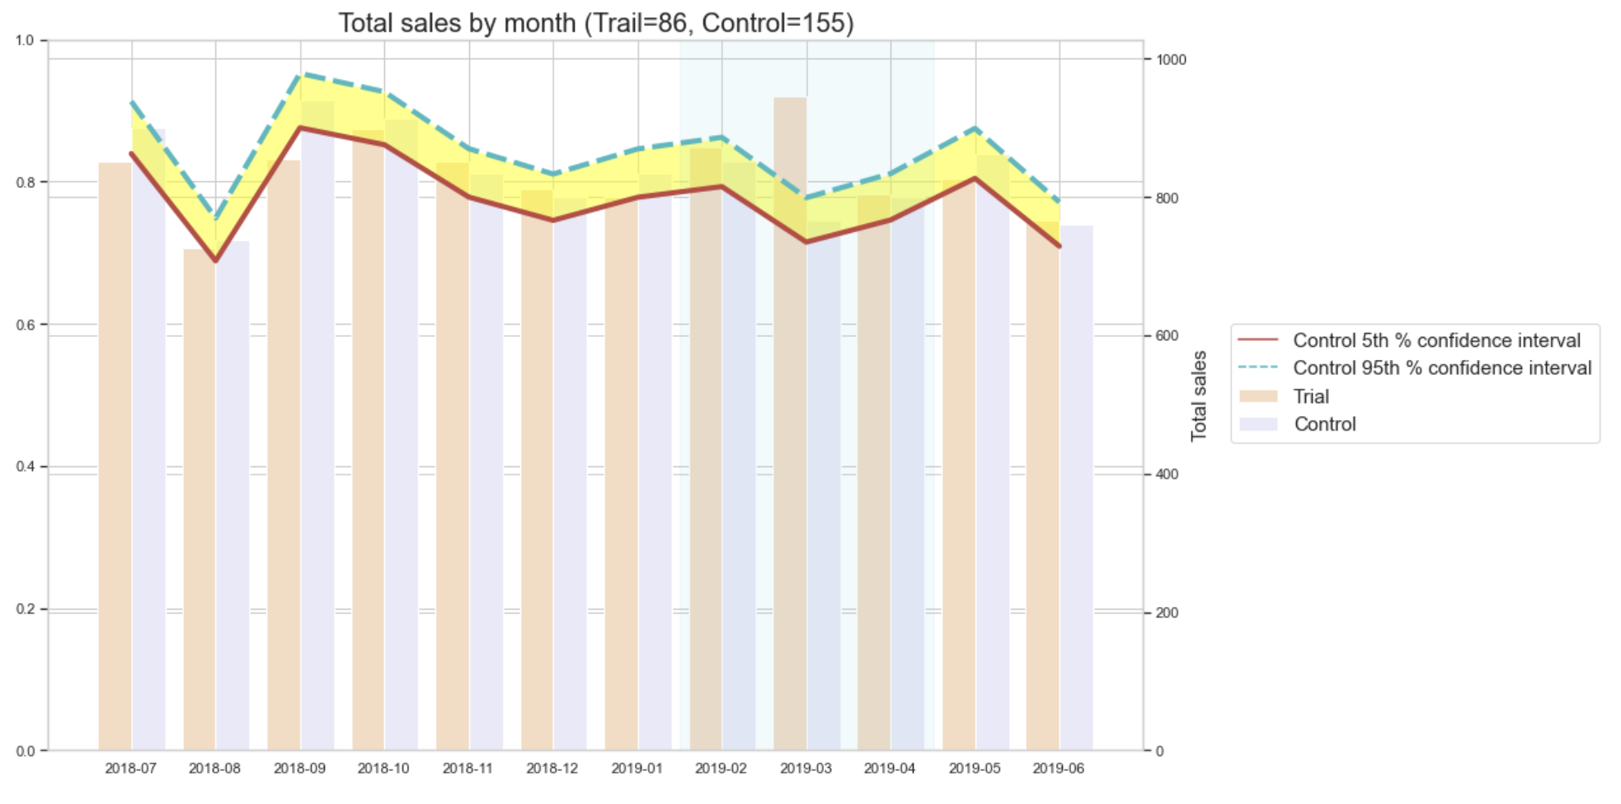
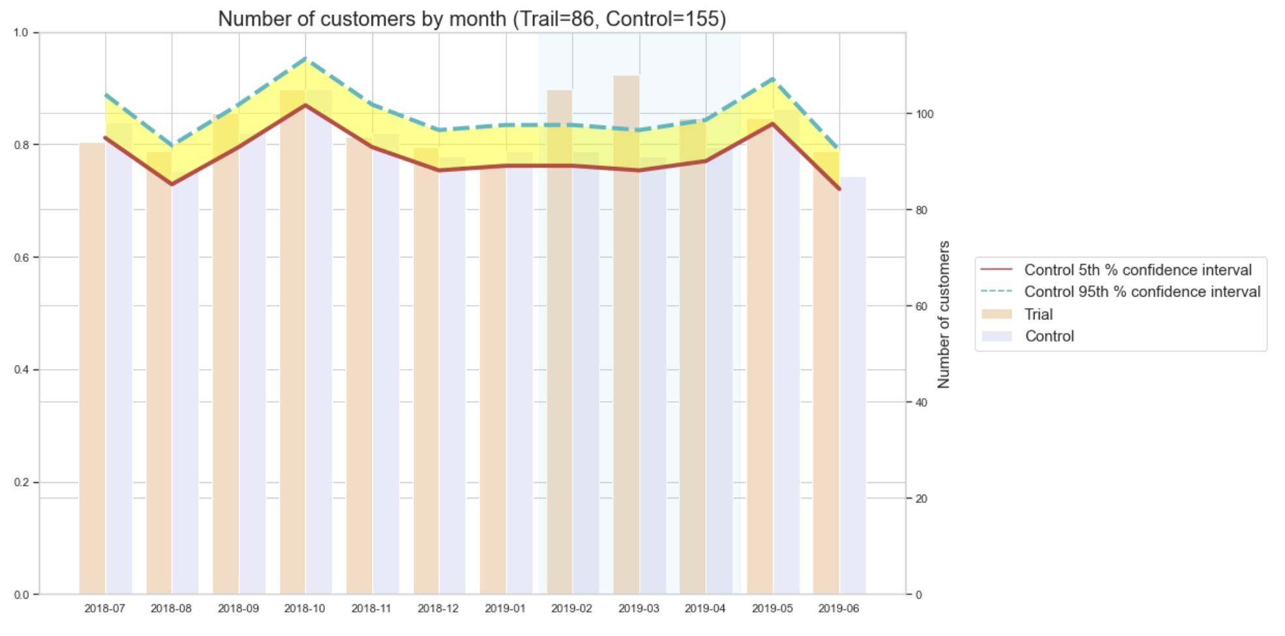
STORE 86
The results show that the trial in store 86 is not significantly different to its control store(155) in the trial period as the trial store performance lies inside the 5% to 95% confidence interval of the control store in two of the three trial months.
It looks like the number of customers is significantly higher in all of the three months. This seems to suggest that the trial had a significant impact on increasing the number of customers in trial store 86 but as we saw, sales were not significantly higher.

Slide 15
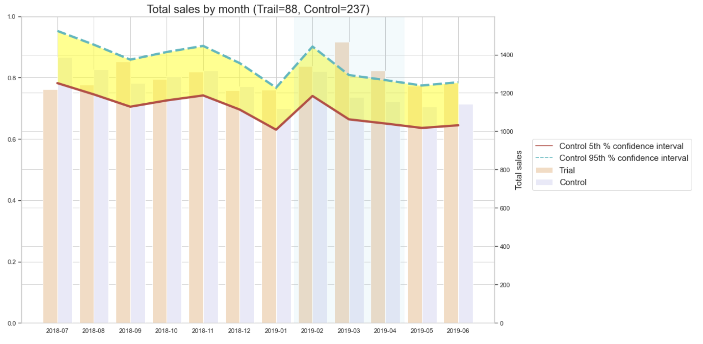
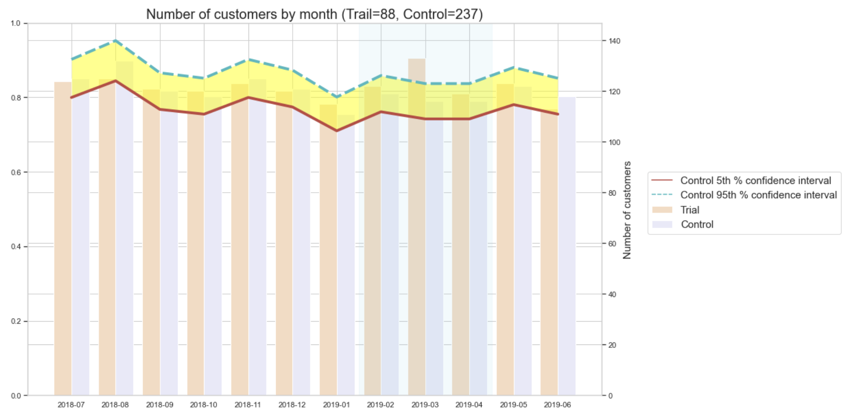
STORE 88
The results show that the trial in store 88 is significantly different to its control store(237) in the trial period as the trial store performance lies outside of the 5% to 95% confidence interval of the control store in two of the three trial months.
Total number of customers in the trial period for the trial store 88 is significantly higher than the control store for two out of three months, which indicates a positive trial effect.

Slide 16
Conclusion
The results for trial stores 77 and 88 during the trial period show a significant difference in at least two of the three trial months but this is not the case for trial store 86.
Overall, the trial stores shows a significant increase in sales.

